Slide 1
10个简单步骤
Ten Simple steps
让安全会议更有效
For successful
safety meetings
博富特咨询
全面
专业
实用

Slide 2
关于博富特
博富特培训已拥有专业且强大的培训师团队-旗下培训师都拥有丰富的国际大公司生产一线及管理岗位工作经验，接受过系统的培训师培训、训练及能力评估，能够开发并讲授从高层管理到基层安全技术、技能培训等一系列课程。
我们致力于为客户提供高品质且实用性强的培训服务，为企业提供有效且针对性强的定制性培训服务，满足不同行业、不同人群的培训需求。
博富特认为：一个好的培训课程起始于一个好的设计,课程设计注重培训目的、培训对象、逻辑关系、各章节具体产出和培训方法应用等关键问题。

Slide 3
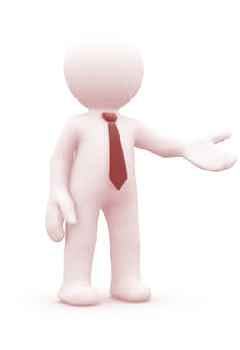
1
步骤1
使会议短而精/Keep it Short and Snappy
平均来说，一个成年人能保持注意力集中的时间是20分钟
The average adult has an attention span of 20 minutes.
尽可能把会议时间控制在20分钟内，这样，在讲到重要内容时，员工才能保持投入和警觉
Try to keep meetings to 20 mins or less when able and appropriate, so you can keep employees fully alert and engaged when important material is presented.

Slide 4
1
步骤2
围绕主题/Get to the Point
不要因为顾及与会的每个人，而试图在一次会议中涵盖五个不同的安全话题
Don’t try to fit five different safety topics into one safety meeting just because everyone is in one room.
最好让每个与会的员工都能专注于一个重要的话题，
并一直围绕着这个话题
It is better to keep employees focused on one important pertinent
topic and to stay on that topic.

Slide 5
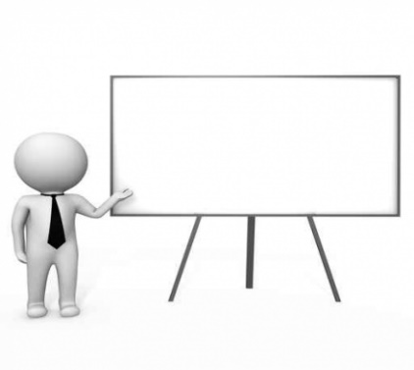
1
步骤3
吸引听众/Engage People
演讲人或发言人不能仅仅只是“读”PPT
Presenters or speakers should never just ‘read’ a presentation to people.
相反，展示过程要吸引人，可以使用实例照片或视频，以及其他的互动技术
Instead, presentations should be engaging and feature real life photos and/or videos along with other interactive forms of technology.
演讲者应该通过一些独特有趣的方法来推动会议的进程The presenter should utilize unique and interesting methods and tools to keep the momentum of the meeting flowing.

Slide 6
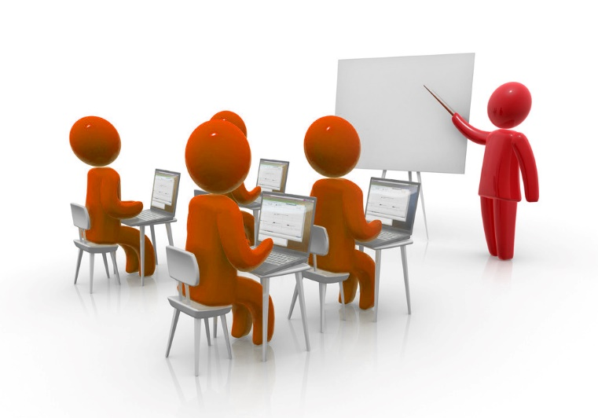
1
步骤4
社交/Socialize
人们爱和他人交际，这是天性使然
By human nature people like to socialize with one another.
即便一个会议的时间很短，也要让与会人员有机会分享自己的相关经历
Even if a meeting is short, build an opportunity into the meeting for people to share stories or experiences pertaining to the safety topic.
关于会议主题的故事分享和交际，使得会议更人性化。Story sharing and socializing about the topic humanizes it.

Slide 7
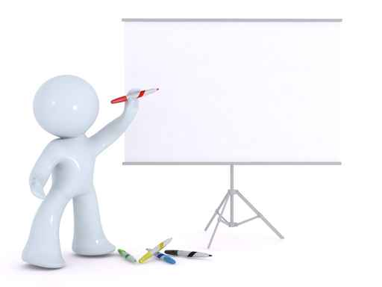
1
步骤5
确保会议的相关性/Make it pertinent
不要把会议时间浪费在不重要的事情上
Don’t waste time holding meetings about unimportant and insignificant things.
选择一个经常对员工有影响，或者对员工职责有所帮助的安全话题
Choose safety topics that affect employees on a regular basis or that are the most helpful based upon their job positions.

Slide 8
1
步骤6
不要邀请他人参会/Don’t Invite Everyone
限制出席条件，安全会议经常能达到最好的效果，发挥最大的影响力
Safety meetings are often best and make the most impact when attendance is limited.
如果有太多人参加会议，与会人员可能会因为害羞而不敢问问题，不能够参与到会议中来
When too many people are present, people tend to shy away from asking questions or being truly engaged..

Slide 9
1
步骤7
使会议具有教育性/Make it Educational
把所有人集中在一起，就是为了回顾一件已经了解过的事情，这没有太大意义
Gathering everyone together just to review something that everyone already knows doesn’t really make much sense.
向员工传达有教育价值的信息非常重要。我们的目标是对员工进行安全教育，不是向他们重复那些已经熟知的内容
It is important to present valuable information that is one of some educational value. The goal is to educate the employee on safety not remind they about something they already know and do.

Slide 10
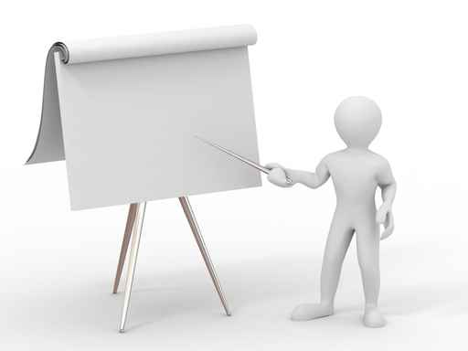
1
步骤8
改变名称/Change the Name
仅仅是叫“安全会议”的话，听起来十分乏味
Just the name ‘safety meeting’ sounds somewhat drab.
相反地，“安全会谈”或是“安全探秘”就很不错Instead, call the something like ’safety conversations’ or ‘safety hints’.
只要稍微改下名称，就会带来很大不同，人们会因为名称的改变而抛弃对“安全会议”的成见
Just a little bit name variety goes a long way and people will lose some of the negative stigma associated with same old boring term ‘safety meeting’.

Slide 11
1
步骤9
增加会议趣味性/Entertain to Engage
演讲者应语调丰富，并在室内适时走动
The speaker should use a variety of different vocal tones to present material and also move about the room.
语调总是一成不变的演讲者，总是容易让人昏昏欲睡
A speaker who simply stands in one spot with a monotone voice will just put employees to sleep.

Slide 12
1
步骤10
反馈非常重要/Feedback is Critical
不管你喜欢与否，他人的观点很重要。当与会人员感到自己的时间被浪费在了没必要的会议上，他们会开始反感这种会议
Whether you like it or not, opinions do matter and when employees feel that their time is being wasted often on unnecessary meetings they will begin to dread such gatherings.
会议快结束时，收集大家的反馈，广泛听取建议，用作改进下一次会议的参考
Ask for feedback at the end of each meeting and be open to suggestions for improvement.

Slide 13
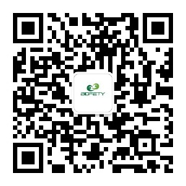
感谢聆听
资源整合，产品服务
↓↓↓
公司官网 | http://www.bofety.com/
如需进一步沟通
↓↓↓
联系我们 | 15250014332 / 0512-68637852
扫码关注我们
获取第一手安全资讯
微信公众号
抖音

