Slide 1
Job Hazard Analysis
Standard Training
Health & Safety
博富特咨询
Owner : SIS
Corporate Training IN-TQ-HSE-009 (0)
全面
专业
实用
Notes:
This training is to :
make AL employees aware of the requirements and of the indirect & direct risks of their job
help AL employees to carry out a JHA
provide AL employees with JHA tools and examples
provide to all AL employees & contractors* a safe & healthy workplace
The JHA will take into account any safety and hazard studies that have been conducted, accident history and risks specific to processes, products and equipment, and will entail a substantiated analysis of the risks associated with each job the work unit entails and the criticality of these risks. Risk assessment will involve the use of a series of risk assessment tables – one for each work unit job – that specify the risk reduction measures and protective systems selected for each risk.
The individual job risk assessment results will be transferred to the summary document, which thus provides an overall evaluation of the occupational hazards for a given work unit.
Recent legislation and regulations in several countries make job hazard analysis mandatory for all types of activities and work environments.
The management of the summary document, including its dissemination, updating, traceability and availability, must be precisely specified. Failure to comply with this obligation may be subject to criminal prosecution in some countries.

Slide 2



关于博富特
博富特培训已拥有专业且强大的培训师团队-旗下培训师都拥有丰富的国际大公司生产一线及管理岗位工作经验，接受过系统的培训师培训、训练及能力评估，能够开发并讲授从高层管理到基层安全技术、技能培训等一系列课程。
我们致力于为客户提供高品质且实用性强的培训服务，为企业提供有效且针对性强的定制性培训服务，满足不同行业、不同人群的培训需求。
博富特认为：一个好的培训课程起始于一个好的设计,课程设计注重培训目的、培训对象、逻辑关系、各章节具体产出和培训方法应用等关键问题。

Slide 3
工作危害分析 (JHA)
测试 #1
介绍
  工作危害分析是…
  工作危害分析是有益的  练习 #1
  工作危害分析是必需的…
  工作危害分析要求…
  工作危害分析是一个小组的努力
工作危害分析的五个步骤
  选择要进行JHA的工作
  把工作分为若干个作业活动 (工作步骤)
  识别危害和降低风险
  执行行动方案
  定期审查
练习 #2: 执行工作危害分析
测试 #2

Slide 4

工作危害分析(JHA)是…
现场对工作安全和健康风险的一个全面的分析
有时, 除了工艺风险分析之外, 还要完成一个工作危害分析*
JHA « 就是仔细观察工作过程中可能对人员产生危害的各种因素,这样你才能评估是否已经采取了足够的预防措施, 或者还必须采取其他防范手段 ».
HSE-UK
* 这两个风险分析可以互相关联, 互相作用
Notes:
A complete process to analyze a job to:
Take into account all hazards which could have a physical or health impact
Injury
Occupational Disease
Identify hazards associated with each task
Prioritize hazards according to level of risk
Develop solutions to
Eliminate,
Prevent,
Mitigate.
Define collective and personal protective equipment
Prioritize corrective actions
Establish Standard Operating Procedures
Inform and Train employees

Slide 5
工作危害分析(JHA)是有益的…
练习 # 1
请给出 JHA主要的好处
Notes:
As examples:
- Increases personnel hazard awareness and risk consequences
- Reduces injuries and diseases
- Contributes to fitness & well-being
- Increases productivity
- Assists in written instructions & standard compliance
Machine guarding,
Personal protective equipment (PPE) compliance …
- Increases training and awareness
- Audits task environment, housekeeping and the SOP
- Helps in incident investigations
- Makes safety and health a part of the production process, not an add-on
- Adapts and optimize means related to hazards
- Discovers real performed work
- Develops solutions to prevent incidents/accidents and occupational disease

Slide 6
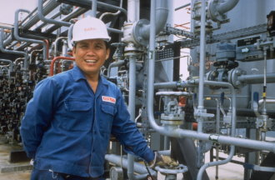


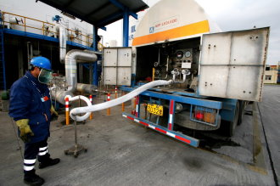
工作危害分析(JHA) 是必需的, 当 …
现场有 :
员工
危险
工作/任务/作业 区间

Slide 7

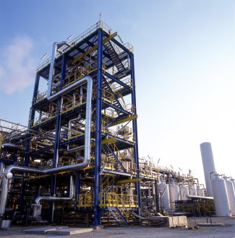
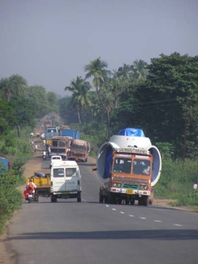
工作危害分析(JHA) 是必需的 …
作为最低要求, 当工作包含危险和要求作业资格时*,
*在许多国家, 法律要求分析所有的工作
特别是针对
  新的工作 / 作业站台
  当工作过程有变更
    在开动一个新设备或新设施之前
    在组织(工作的组织方式或管理组织)进行变更之前
    在改变工作/作业之前
  定期对正在进行的工作
    验证作业没有改变
    验证执行了预防&保护安全措施及行动
例如: 最低要求, 法国每年; 德国每3年, 荷兰每5年, …
Notes:
Examples of jobs requiring qualification :
1) GT-TQ-COM-001 (0) TRAINING AND QUALIFICATION METHODOLOGY FOR INDUSTRIAL AND MEDICAL OPERATORS AND TECHNICIANS
Acetylene, Nitrous Oxide and Carbon Dioxide Plant Operators
Bulk and Cylinder Drivers (all business lines including Healthcare and Homecare)
Industrial and Medical Fill Center and Retest Center Operators
Specialty Gas Center Operators (Industrial Customers business line)
Field Service Technician (Customer Installations and On sites)
Technicians in Homecare activities
Electronics Carrier Gases Platform Operators and Technicians
Electronics Carrier Gases Platform QA/QC Specialists
Total Gases and/or Chemical Management Operators and Technicians
Total Gases and/or Chemical Management QA/QC Specialists
ASU Operators and Technicians
HYCO Operators and Technicians
HPU Operators and Technicians
COGEN Operators and Technicians
Pipeline Technicians
2) GT-TQ-COM-002 (0) TRAINING AND QUALIFICATION METHODOLOGY FOR INDUSTRIAL AND MEDICAL MANAGERS AND ENGINEERS
ASU, HYCO, HPU and COGEN Facility Managers
ASU, HYCO, HPU and COGEN Production Managers
ASU, HYCO, HPU and COGEN Maintenance Managers
ASU, HYCO, HPU and COGEN Facility Engineers
Electronics Carrier Gases Platform Managers and Facility Engineers
Total Gases and/or Chemical Management Managers and Facility Engineers
HSE Managers
Risk Management Representatives
Chief Industrial Auditor
…

Slide 8
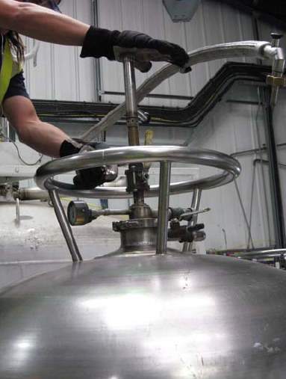
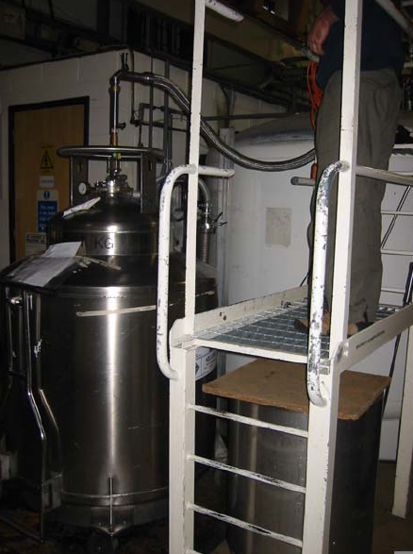

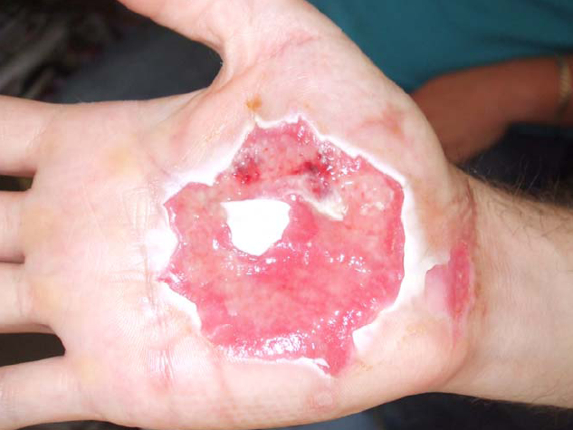
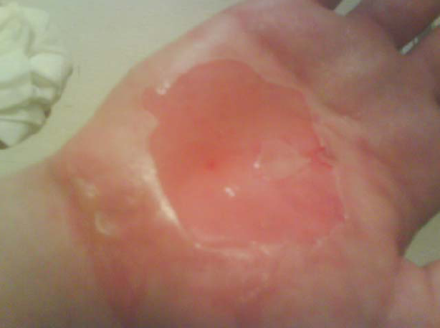
工作危害分析(JHA) 是必需的 …
预防事故
用手去堵住氦气出口 …
… 在连接软管之前 .
事故发生后一周
冻伤, 事故发生后的第二天…

Slide 9
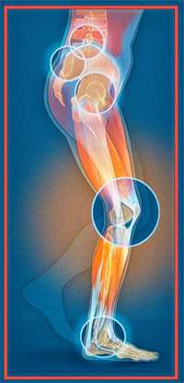
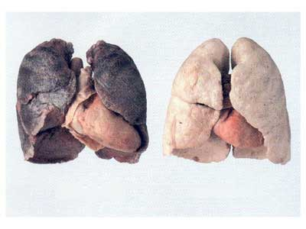
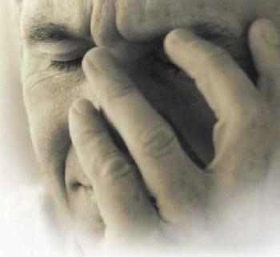
工作危害分析(JHA) 是必需的 …
预防职业病, 例如 :
✓ 肌肉骨骼损伤疾患 (MSDs)
✓ 高毒或者长期毒性效果
 癌,
 致变异,
 致生殖毒性
✓ 精神压力

Slide 10


工作危害分析(JHA) 是必需的,按照 …
液空 蓝皮书
  IMS GP 06 第 4.4节
“装置经理, 在HSE经理的支持下,至少应确保对包含危险的工作应开展工作危害分析” …
  IMS GP 07 第 4.1节
“所有人员应接受关于HSE, 现场特定危险和工艺过程的培训”…
Notes:
JHA is also required by law
International Labor Organization (ILO)
http://www.ilo.org/ilolex/english/convdisp1.htm
(En, Fr, Es, D, Ru, Ch, Ar, P)
Conventions :
C187 Promotional Framework for Occupational Safety and Health Convention, 2006
C170 Chemicals Convention, 1990
C167 Safety and Health in Construction Convention, 1988
R164 Occupational Safety and Health Recommendation, 1981
C162 Asbestos Convention, 1986
C155 Occupational Safety and Health Convention, 1981
C148 Working Environment (Air Pollution, Noise and Vibration) Convention, 1977
C139 Occupational Cancer Convention, 1974
As example : European Directive 2009/104/CE (89/391/CEE) for European Union (EU)
 All employers must provide work and workplaces that are safe and respect personnel’s health.

Slide 11
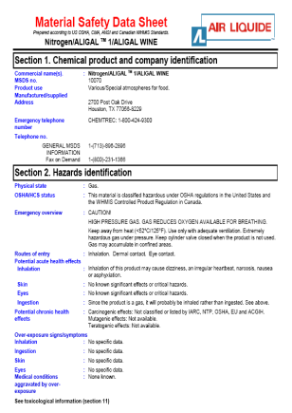

工作危害分析(JHA)要求事先获取的信息
您可以获取的信息
  当地医疗, 专业医师…
  当地安全专业单位
  当地人力资源, 健康安全环境, 专家, …
  当地和集团事件/事故报告
  事故风险分析 (ARA)
  液空标准
  化学品安全技术说明书 (MSDS)
  技术资料 (机器, …)
  标准, 法规, 好的操作实践方法, …
  对相似工作进行巡视获得的观察结果, …
Notes:
Before beginning the risk assessment phase, we recommend setting up a committee to be chaired by the site manager and consisting of the following members who will contribute any risk assessments they may have already made:
Ø Employee representatives
· Present the hazard analyses they have conducted pursuant to local regulations
Ø Physiotherapist
· Presents the entity's health and safety risks
· Presents specific cases of medical surveillance
Ø Employer's representative (specify who for AL, i.e. a site manager, safety manager, etc.)
· Presents the forms submitted to national health insurance funds
· Presents jobs that entail specific risks.
Technical manager
· Presents material safety data sheets (MSDS).
· Presents equipment and machinery risks (this document is sent to labor inspection authorities).
· Presents process risks, particularly for high-risk classified sites, pursuant to government regulations.
· Presents job risk data sheets.
· Presents a generic description of the job(s) of a given work unit (e.g.: operator, driver, filler, welder, customer-service technician, plant shift supervisor, secretary, etc..) in compliance with "competency profiles", if any.
The safety coordinator will present experience feedback, including such information as the types, seriousness and frequency of accidents, for a specific type of activity (e.g. metallurgy, gases, chemicals, etc.) for the Group and for the entity. Broken down by work unit.

Slide 12


工作危害分析(JHA)是一个小组的努力
谁是负责人?
  装置/现场经理 (IMS-GP06)在HSE经理的支持下
谁应该参加工作危害分析(JHA)?
  员工 (强制性)
  直接主管 (强制性)
  人力资源经理
  主管
  医疗和技术专家
  当地社区代表
  第三方专家
  …
Notes:
Before beginning the risk assessment phase, we recommend setting up a committee to be chaired by the site manager and consisting of the following members who will contribute any risk assessments they may have already made:
Ø Employee representatives
• Present the hazard analysis they have conducted pursuant to local regulations
Ø Physiotherapist
• Presents the entity's health and safety risks
• Presents specific cases of medical surveillance
Ø Employer's representative (specify who for AL, i.e. a site manager, safety manager, etc.)
• Presents the forms submitted to national health insurance funds
• Presents jobs that entail specific risks.
Technical manager
• Presents material safety data sheets (MSDS).
• Presents equipment and machinery risks (this document is sent to labor inspection authorities).
• Presents process risks, particularly for high-risk classified sites, pursuant to government regulations.
• Presents job risk data sheets.
• Presents a generic description of the job(s) of a given work unit (e.g.: operator, driver, filler, welder, customer-service technician, plant shift supervisor, secretary, etc..) in compliance with "competency profiles", if any.
The safety coordinator will present experience feedback, including such information as the types, seriousness and frequency of accidents, for a specific type of activity (e.g. metallurgy, gases, chemicals, etc.) for the Group and for the entity. Broken down by work unit.

Slide 13
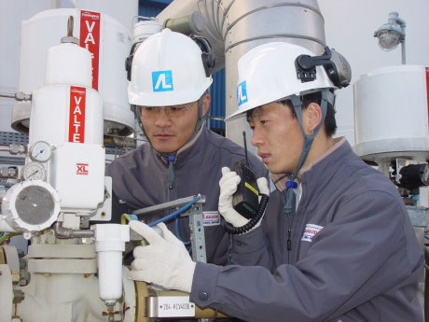
实施工作危害分析(JHA)的5个步骤
步骤 1
明确要进行JHA的工作
步骤 5
定期复审*
步骤 2
把工作分为若干个作业活动(作业步骤)
步骤 4
实施行动方案
步骤 3
识别及降低危害风险
* 许多国家, 法律要求每年一次

Slide 14
JHA 步骤 1: 明确要进行JHA的工作
优先选择的液空工作 (IMS-GP06) :
  发生事故和伤害几率大的工作
  可能导致严重或致残的伤害事故,疾病或精神压力
  作业时一个简单的失误就可能导致严重伤害事故或事件
  新的操作或者程序上有改变
  需要书面说明的复杂作业
  这种工作发生过很多次轻微的伤害
然后, 所有其他液空的工作
最后是转包合同工作
  对于这类工作 (例如: 气体配送或维护工作), 我们须将我们的设备/产品风险或我们现场存在的风险告知他们。

Slide 15
JHA 步骤 2: 将工作划分为若干个作业活动(=作业步骤)
实地观察工作过程并与作业人员一起讨论
  以便于发现他们在做什么,为什么这样做及每项作业步骤的风险
  多次观察
  回顾过去发生的事故/事件报告和BSV记录
  将工作划分为若干个作业步骤 (= 可观察到的活动,身体位置,手势)
  ☞ 拍照及摄像能起到帮助作用
        客观, 事实, 精确 (不是解释, 不是判断)
列出观察到的已知的工作步骤并给出
  最好控制在5 到 15 个步骤
  描述这些作业步骤
  和员工确认工作步骤顺序
Notes:
Involve the employee
The employee can help the observer better understand the work being done,
The more involved the employee is, the better the chances of a buy-in.
It is an excellent opportunity to promote safe behavior
These analyses may be done generically for positions.

Slide 16



JHA 步骤 3: 识别&降低危害风险
识别:
  身体和健康方面的危害
    不安全的工作条件
      重的负载, 驾驶, 隔离作业的人员, …
    不安全的设备
      无防护装置的转动部件, 电, …
    不安全的环境
      噪声, 照明, …
    不安全的物料
      有毒物料, …
    不安全的组织
      缺少培训, 作业组织方式…
  客户或第三方现场存在的危害身体和健康方面的风险

Slide 17
JHA步骤 3: 识别&降低危害风险
考虑过去发生的事情 (事故, 事件, 行为安全观察报告 …)
危害风险清单
根本原因分析

Slide 18
JHA步骤 3: 识别&降低危害风险
控制危害风险的层次
  我们是否能消除危害? ❶
  我们是否可以通过下列措施控制风险 ❷
    设计或工程解决办法,
    组织方式和/或程序上的办法?
  我们是否通过下列措施能削减风险造成的后果 ❸
    多人防护设备,
    个体防护装备 (PPE)?
为了达到可接受的残余风险水平
上面的一个或多个防护控制措施可能是必需的
将防护措施和好的操作实践去比较, 可以检查哪些是相关的。
Notes:
Overall examples :
The actions to take to eliminate or minimize the hazards are:
Eliminate hazardous products (water/solvent)
Change production’s parameters (Production at high temperature/at ambient temperature)
Locate equipment or installations in another place (Liquid CO2 storage close to / far from sewage sludge storage area)
Change the production process
Design or Engineering controls
Substitute by less hazardous products (Change gasket’s material, …)
Design, including collective protection equipment/devices (Safety valves, gear machinery cover, …)
Organize process in order to mitigate risks (Reduce the number of loading/handling tasks, equipment designed with enough space to maintain it …)
Organization and procedure
Alter the sequence or process to reduce the hazard (Does the job have to be performed? Can it be done less often? Can the job be performed in another way? Can you make physical changes to the job? Are the operating and emergency procedures issued and applicable? Are warning signs and barriers in place? Is emergency equipment available?)
Mitigation measures
Collective protective equipment: First choose collective protective equipment (stationary gas detector, room entry prohibition system, …); Define the organization in case of alarms or emergency
Personal Protective Equipment: When exposure to hazards cannot be completely engineered out, and when safe work practices and administrative controls cannot provide sufficient additional protection from exposure, if ( and only if ) the level of residual risk is acceptable (green zone) and personal protective clothing and/or equipment (such as portable detectors) could definitively protect the worker, then, PPE may be required. This is the last barrier to reduce consequences (severity) of a hazard

Slide 19
JHA 步骤 4: 实施行动方案
工作条件必须能让人员安全地执行作业
一个好的行动方案常常包括几个互补的行动, 如:
  少数便宜且易做到的改进措施能够很快的完成, 比如
    临时方案, 直到更可靠的控制措施到位,
    对更可能导致事故或职业疾病的采取永久性方案,
    对可能导致极坏后果的采取永久性方案。
  定期检查,确保防护控制措施在现场有效
  明确责任人和完成时间表

Slide 20
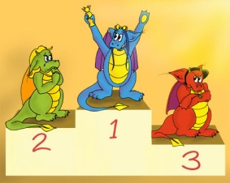

JHA 步骤 4:实施行动方案
行动方案可能涉及到:
  设备或工艺流程设计的修改
  工作组织方式或工作流程的改变
  编制标准作业程序(SOP)或者更新
  培训设计, 修改和实施
  多人或个体防护装备的采购
  标识
  将风险告知作业人员 …
使用一个实用的文件予以总结
如:在法国,使用Document Unique文件记录实施情况
Notes:
The analysis shall be used to develop mitigation plans and protective measures which include collective and personal protective equipment (PPE), safety instructions, trainings and installation of safety devices such as fire protection systems and extinguishers, man-down systems, warning signs, toxic and flammable gas detectors, disinfection, psychological support etc. These analyses shall also help at facility level to define the needs for:
· Rescue teams and HSE training,
· First aid,
· External assistance, such as emergency medical and/or fire department response.
The HSE Manager shall manage this process at the entity level and ensure, through inspections,
that job hazard analyses are complete and regularly updated as necessary.
Inform and train all employees on JHA conclusions:
Hazards and hazardous situations,
Preventive and Corrective measures,
Rules that employees shall respect
Feedback organization in case of implementation difficulties
Safety Emergency Organization

Slide 21
JHA 步骤 5: 定期复审
确保风险危害状况是
  相关人员知道的
确保“规定"是
  了解的
  运用的
  有效的
       你可以使用行为安全观察( BSV), 审计, 人体工程学研究, …
应考虑下列事项
  执行规定, 标准操作程序(SOP)遇到的困难, …
  缺少安全装置或程序, …
  法规,规定的变动,
  装置/设施的变更
  工作任务的变化,
  任一 “新的” 事件/事故
为改进预防/保护措施
 关闭, 定期更新 JHA*
* 在许多国家, 法规要求每年复审一次

Slide 22
JHA 记录表单示例
为记录JHA的结果, 可以使用一个excel表格
参见下面表单

Slide 23


感谢聆听
资源整合，产品服务
↓↓↓
公司官网 | http://www.bofety.com/
如需进一步沟通
↓↓↓
联系我们 | 15250014332 / 0512-68637852
扫码关注我们
获取第一手安全资讯
微信公众号
抖音

